Slide 1

Understanding Career Aspiration Of Gen Z
Present By:
Sairaj B. Kale

Slide 2
Learning Roadmap
Introduction to the problem statement and researching about it
Approaching the problem and creating a problem statement document
Collecting and cleaning data using Excel
Analyzing the data using Excel and PostgreSQL
Step 1
Step 2
Step 3
Step 4
Creating an Excel dashboard
Creating a Power BI Functional Focus Area Dashboard
Deriving final insights
Step 5
Step 6
Step 7

Slide 3
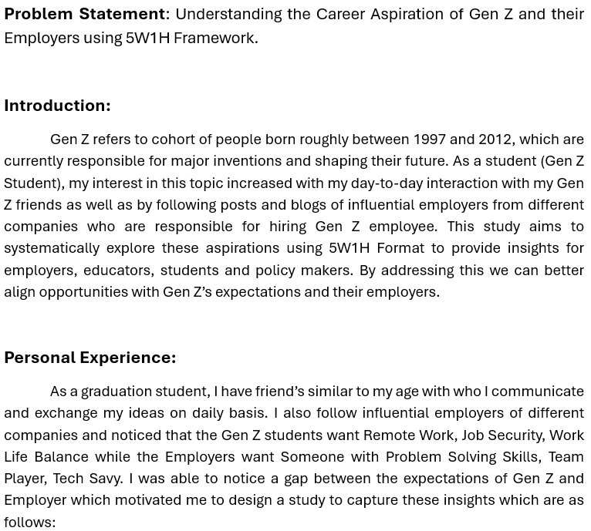
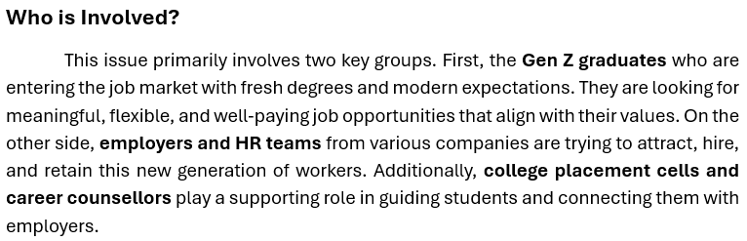
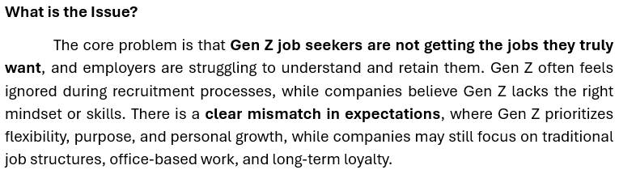
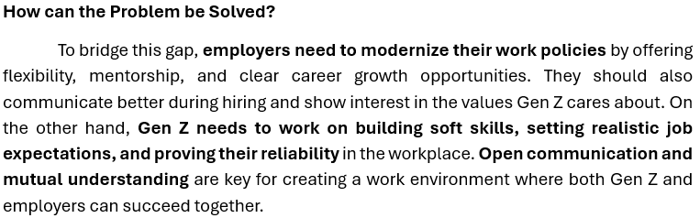
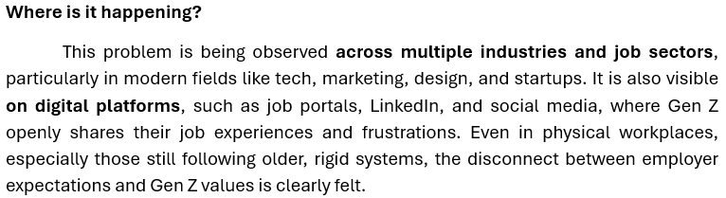
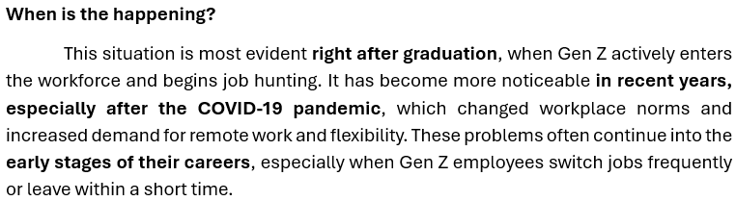
Problem Statement Documentation

Slide 4
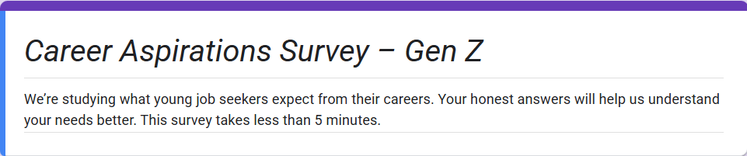
Data Collection for the Project
Data collection is the first and most crucial step in any data analysis process.
This step ensures that the data collected is relevant, accurate, and useful.
Without proper data collection, the insights drawn from analysis can be misleading or incomplete.
Effective data collection lays the foundation for meaningful analysis and better decision-making.

Slide 5
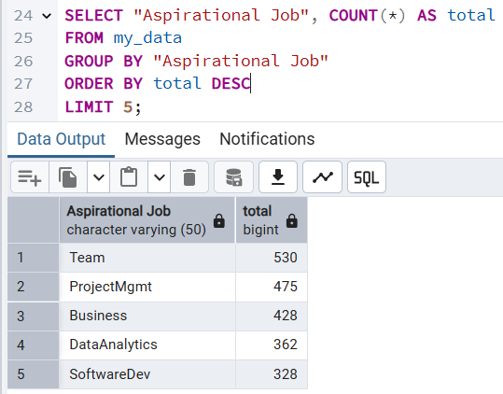
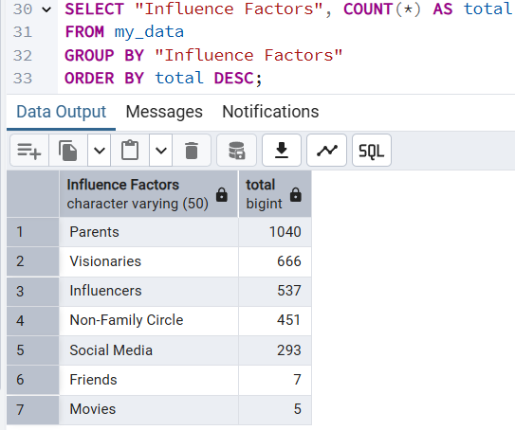
Data Analysis Using Postgresql
PostgreSQL is a powerful open-source relational database system used for storing and analyzing structured data.
During this project, I imported CSV data into PostgreSQL and used SQL queries to solve real-world business questions, such as identifying top aspirational jobs and analyzing work preferences.
PostgreSQL allows analysts to perform complex queries, group data, filter results, and extract insights directly from the database, saving time and improving accuracy.

Slide 6
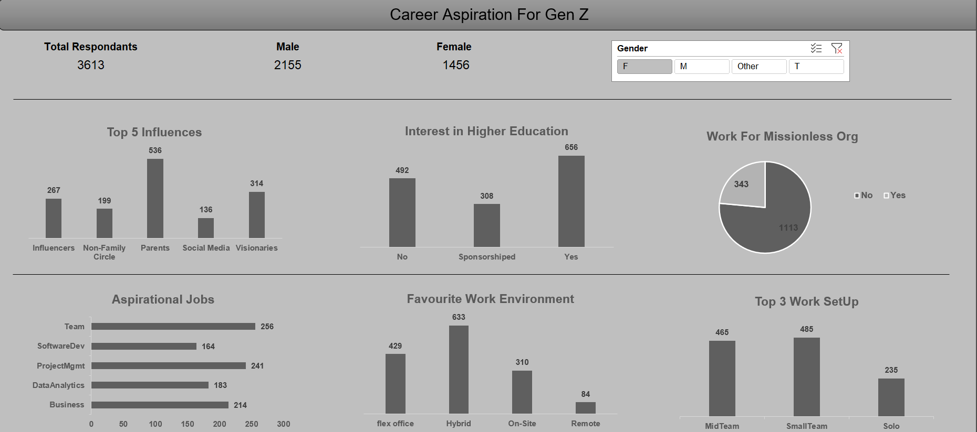
Comprehensive Dashboard

Slide 7
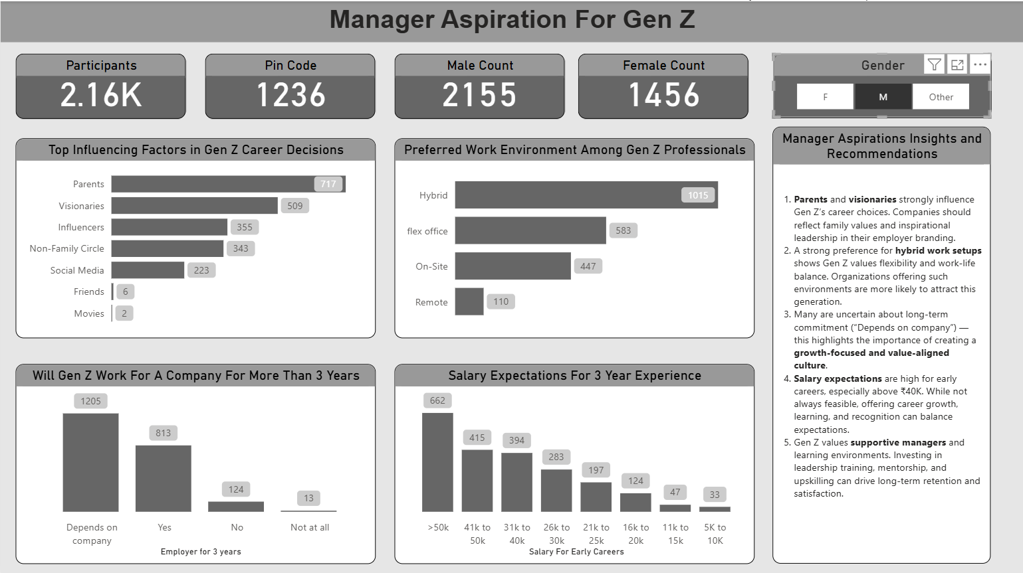
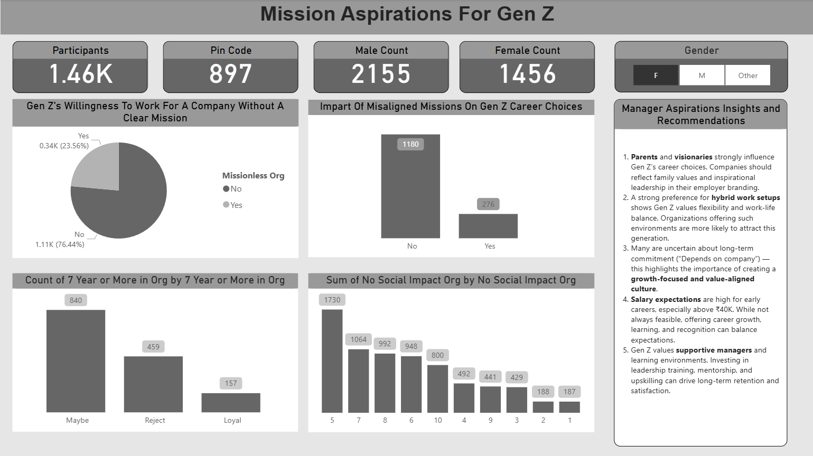
Focus Area Dashboards
We made two focused dashboards along with one comprehensive dashboard . These two dashboards were based of two aspects :
Manager Aspirations of Gen Z
Mission Aspirations of Gen Z

Slide 8
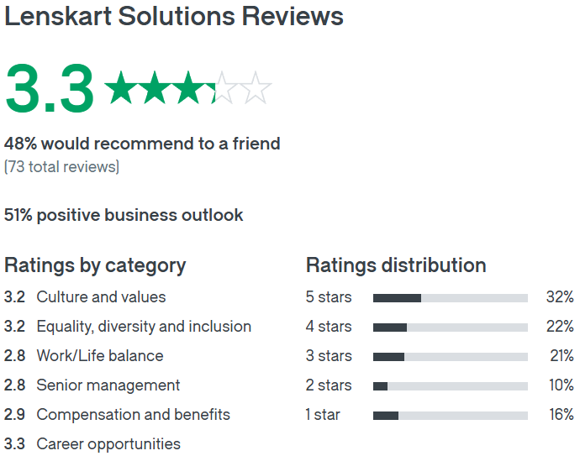
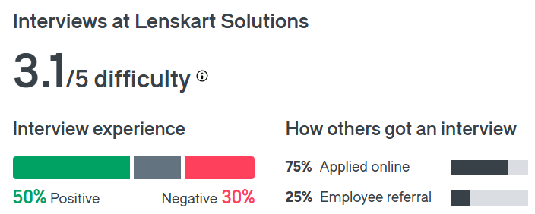
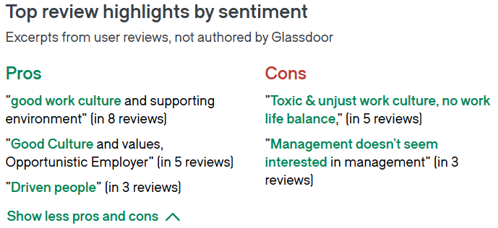
Lenskart
Problems At Lenskart
Employees at Lenskart report low satisfaction in work-life balance and compensation, with only 48% willing to recommend the company.
Lenskart employees rate compensation poorly (1 star), showing Gen Z isn’t receiving expected pay in early career stages.

Slide 9
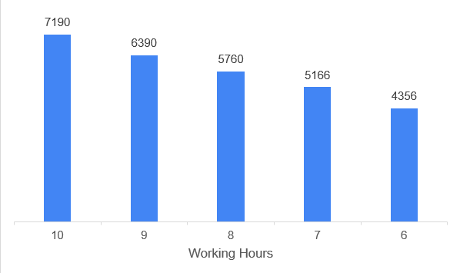
Problem Statement: Employees at Lenskart report low satisfaction in work-life balance and compensation, with only 48% willing to recommend the company.
Solution
Introduce structured and manageable working hours to reduce burnout and support a healthier work-life balance for Gen Z employees.

Slide 10
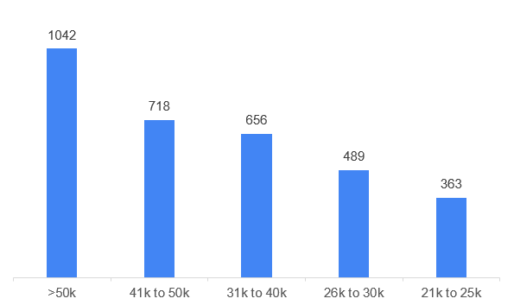
Problem Statement: Lenskart employees rate compensation poorly (1 star), showing Gen Z isn’t receiving expected pay in early career stages.
Solution
Offer transparent and competitive starting salaries to match Gen Z expectations and improve retention.

Slide 11
THANK YOU !!!

